Slide 1

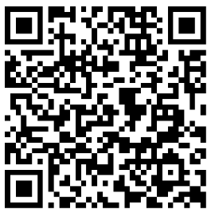
CABINET
Dr Skander Kamoun

Slide 2


